Slide 1
ECE 352 Digital System Fundamentals
Introduction to K-Maps
Notes:
In this presentation, we will introduce the Karnaugh map, which we will use to perform 2-level logic optimization.

Slide 2
Optimizing Boolean Functions
Optimization by algebraic manipulation can create an optimal implementation, but…
There is no set procedure for how to proceed
Can be difficult to see when “optimal” is achieved
Karnaugh Maps (aka “K-maps”)
Visual Boolean function representation
Allows for a systematic optimization
Same info as a truth table, but different organization
Really applying Boolean Algebra simplification!
We will use K-maps for functions of up to 4 variables, after that it gets difficult to visualize…
Notes:
We can find optimal 2-level circuits using algebra, but it can be difficult. There is no set procedure for how to manipulate the Boolean function, and it is not always obvious if you’ve found an optimal solution.
The Karnaugh map (commonly referred to as a K-map) is a visual method for finding an optimal solution. The K-map has exactly the same information as the truth table, but organized in a way that makes it simple to identify which minterms should be combined to create optimal terms. As we’ll see, K-maps actually apply Boolean algebra simplifications to do this.
However, K-maps are generally limited to minimizing functions of up to 4 variables—we’ll show you why later in this video.

Slide 3
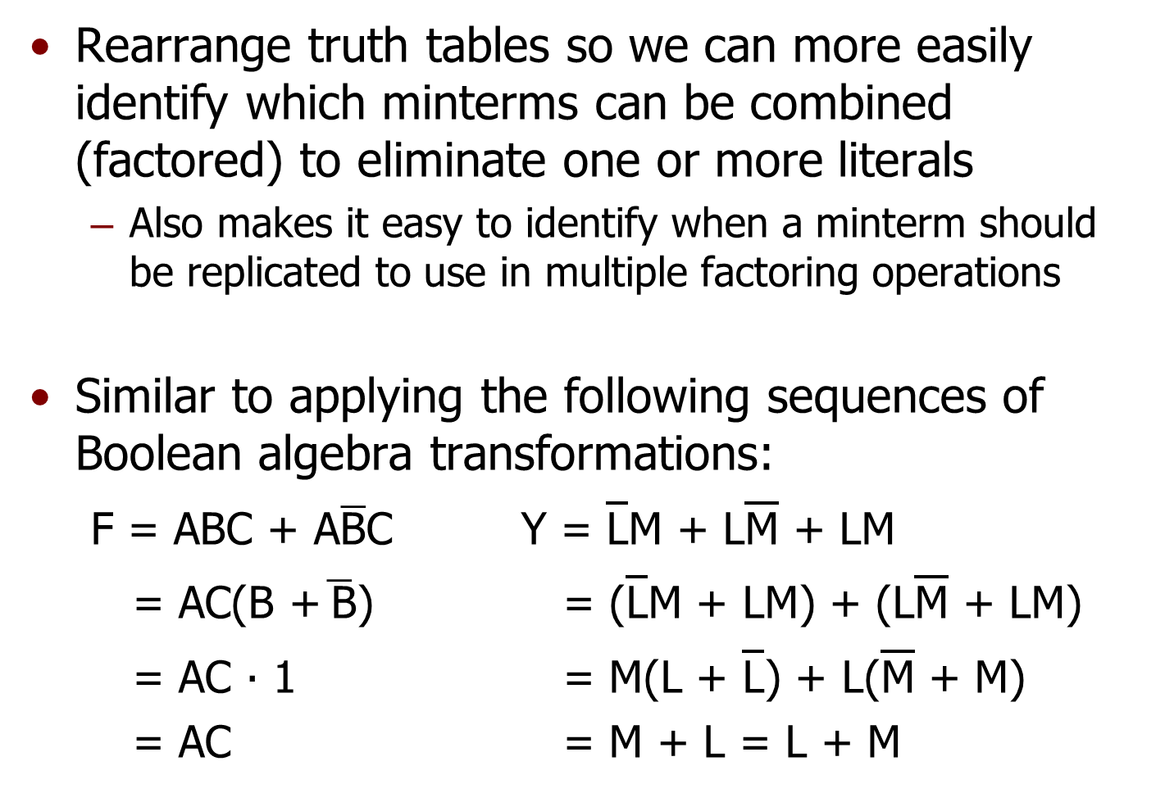
Basic Idea of K-Maps
Rearrange truth tables so we can more easily identify which minterms can be combined (factored) to eliminate one or more literals
Also makes it easy to identify when a minterm should be replicated to use in multiple factoring operations
Similar to applying the following sequences of Boolean algebra transformations:
$\text{F}\text{ = }\text{ABC}\text{ + }\text{A}\overline{\text{B}}\text{C}$ Y = $\overline{\text{L}}$M + L$\overline{\text{M}}$ + LM
= $\text{AC}\text{(}\text{B}\text{ +}\overline{ \text{B}}\text{)}$ = ($\overline{\text{L}}$M + LM) + (L$\overline{\text{M}}$ + LM)
= AC ∙ 1 = M(L + $\overline{\text{L}}$) + L($\overline{\text{M}}$ + M)
= AC = M + L = L + M
Notes:
The K-map is organized so that any minterms that can be combined by factoring are adjacent to each other in the map. The K-map also inherently identifies which minterm(s) need to be replicated to aid in factoring. The function on the left can be minimized with straightforward factoring. However, to fully simplify the function on the right, you need to recognize that the LM term must be replicated. This hard to see, especially if there are lots of terms in the function. The K-map will help us identify both of these situations. Later in the video, we’ll re-examine the function at right and show how it is much easier to find the solution using a K-map.

Slide 4



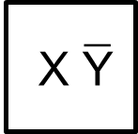

Two-Variable K-Maps
A two-variable function has 4 minterms, so a two-variable K-map has four squares
The key to K-maps:
Adjacent squares represent minterms that can be combined to “drop” a literal
Y
X Y minterm
0 0 $\overline{\text{X}} \overline{\text{Y}}$
0 1 $\overline{\text{X}} \text{Y}$
1 0 $\text{X} \overline{\text{Y}}$
1 1 $\text{X} \text{Y}$
X
0
1
0
$\overline{\text{X}} \overline{\text{Y}}$
$\overline{\text{X}} \text{Y}$
1
$\text{X} \overline{\text{Y}}$
$\text{X} \text{Y}$
Notes:
A 2-variable function has a truth table with 4 rows, and 4 possible minterms. So, a 2-variable K-map has 4 squares.
The axes are labeled with the possible values for X and Y, and the truth table information from each row is copied into it. In other words, we’ve converted the table into a grid, and the bits of the minterm index are the coordinates. Minterm m2 is located in the box where X=1 and Y=0. If there is a 1 in a square, it means the function contains the corresponding minterm.
Notice that any two squares that are either horizontally or vertically adjacent represent minterms that differ by exactly 1 literal. This means we can combine adjacent minterms by factoring the part they have in common.

Slide 5
Two-Variable K-Map Examples
B
A B F
0 0 0
0 1 1
1 0 0
1 1 1
A
0
1
0
0
1
1
0
1
Notes:
To use a K-map, we first populate it from the truth table.

Slide 6

Two-Variable K-Map Examples
B
$$\text{F}\text{ = }\text{B}$$
A B F
0 0 0
0 1 1
1 0 0
1 1 1
A
0
1
0
0
1
1
0
1
The K-map highlights the fact that A can be eliminated by showing:
F = 1 whenever B = 1, regardless of the value of A
F = 0 whenever B = 0, regardless of the value of A
For SoP form, we group 1s, and include the corresponding product term(s) in our equation
Notes:
In this example, the function has two minterms, /A·B and A·B, that are in adjacent squares of the K-map. Since the two 1’s are adjacent in the K-map, we can group them and eliminate the literal that is different in the two minterms.
Pause for a moment and prove to yourself that you would get the same result by factoring these two minterms.

Slide 7
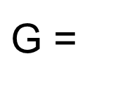


Two-Variable K-Map Examples
D
$\text{G}$ =
$$\overline{\text{C}}\text{D}$$
$$\text{+ }\text{C}\overline{\text{D}}$$
C D G
0 0 0
0 1 1
1 0 1
1 1 0
C
0
1
0
0
1
1
1
0
We need to make sure all 1s* are in some group (to include all of the 1s in the truth table)
But we can only group 1s into the same group if they are adjacent
Sometimes the most simplified SoP version of a function is actually sum of minterms form…
* Later we’ll see an example of grouping 0s
Notes:
In this example, the function also has two minterms, this time /A·B and A·/B. However, they are NOT in adjacent squares of the K-map, so the terms cannot be combined. The largest groupings possible are each just a single minterm.
So, the simplest form of this function is simply the sum of its minterms—no further minimization is possible.

Slide 8
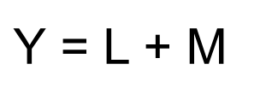
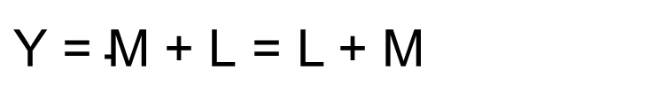



K-Maps Versus Algebra
L M Y
0 0 0
0 1 1
1 0 1
1 1 1
Using a K-Map:
Solving Algebraicly:
Write the function
as a sum of minterms
M
L
0
1
0
0
1
$\text{Y}\text{ = }\overline{\text{L}}\text{M} \text{+ }\text{L}\overline{\text{M}}$ $\text{+} \text{LM}$
To factor, you need to OR in a redundant LM term
1
1
1
$\text{Y}\text{ = }\overline{\text{L}}\text{M}$ $\text{+} \text{LM}\text{ + }\text{L}\overline{\text{M}} \text{+} \text{LM}$
$\text{Y}\text{ = }\left(\overline{\text{L}} \text{+ }\text{L}\right)\text{M}$ $\text{+} \text{L}\left(\overline{\text{M}} \text{+ }\text{M}\right)$
$\text{Y}$ = L + M
$\text{Y}\text{ = }\text{M}$ $\text{+} \text{L}$ = L + M
Note that the redundant term needed for factoring is the minterm that is in both K-map groups!
Notes:
We’ll go back to one of the earlier examples in this video to illustrate the relationship between K-map groupings and Boolean algebra. You might already recognize that the truth table is an OR gate, but let’s ignore that for now...
Using a K-map filled out from the truth table, you can see that there are two possible groupings, and directly find the optimized function Y = L + M.
To solve algebraically, we begin by writing the function as a sum of minterms based on the truth table. To factor this we need to OR in a redundant LM term and do the math to get the same answer as the K-map.
Note that the redundant minterm we needed was in fact the term that was grouped twice in the K-map – this is not a coincidence. We used the minterm twice in the K-map, just like we used it twice when optimizing algebraically.

Slide 9
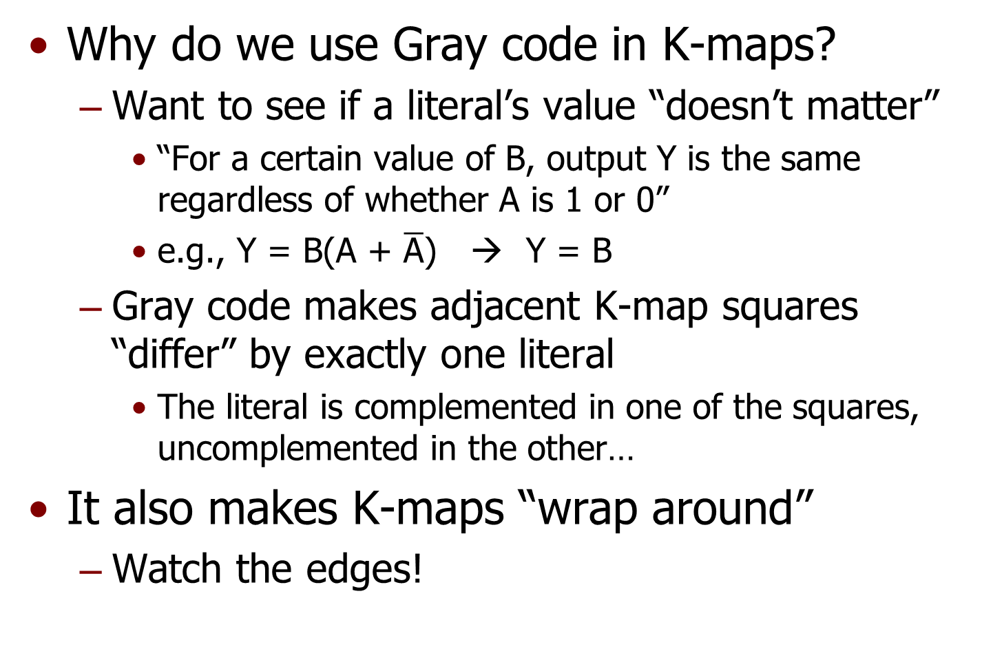
K-Maps Use Gray Code
Why do we use Gray code in K-maps?
Want to see if a literal’s value “doesn’t matter”
“For a certain value of B, output Y is the same regardless of whether A is 1 or 0”
e.g., Y = B($\text{A}\text{ + }\overline{\text{A}}$) → Y = B
Gray code makes adjacent K-map squares “differ” by exactly one literal
The literal is complemented in one of the squares, uncomplemented in the other…
It also makes K-maps “wrap around”
Watch the edges!
Notes:
What makes K-maps work is the fact that the minterms corresponding to adjacent squares only differ in one literal. To keep this true in large K-maps, we need to use a Gray code to label the axes. Actually, the 2-variable K-map also uses Gray code to label each axis, but you can’t tell because it’s just one bit.
Gray code also means that the K-map “wraps around” at the edges – the first and last squares in any row or in any column are also adjacent. Keep that in mind as you use K-maps.

Slide 10
Three-Variable K-Maps
A three-variable function has 8 minterms
The K-map is usually organized as a 4x2 array (i.e. two variables on horizontal)
The numbers on the two-variable axis follow a Gray Code, not a binary, count
YZ
X
00
01
11
10
0
m0
m1
m3
m2
1
m4
m5
m7
m6
Notes:
For three variables, we normally organize the K-map as shown. Remember that the axis labeling always follows a Gray code count.

Slide 11
Three-Variable K-Map Examples
Remember Gray code when filling in K-Map!
A B C F
0 0 0 0
0 0 1 1
0 1 0 0
0 1 1 1
1 0 0 1
1 0 1 1
1 1 0 1
1 1 1 1
BC
A
00
01
11
10
0
0
1
1
0
1
1
1
1
1
Notes:
When filling in the K-map from the truth table, be careful! It’s easy to make a mistake if you aren’t paying attention.

Slide 12
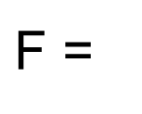

Three-Variable K-Map Examples
Can have more than two 1s in a group
Size of a group in each direction must be a power-of-two:
1x1, 1x2, 2x4, 4x1…
F is always 1 if C is 1, regardless of A, B values
BC
A
00
01
11
10
0
0
1
1
0
1
1
1
1
1
$\text{F}$ =
A
$$\text{+ }\text{C}$$
F is always 1 if A is 1, regardless of B, C values
F is 1 if either of A or C are 1
Notes:
We can group more than two minterms, but the dimensions of a group must always be powers of two. In this example, we can group the four lower 1s, which results in the term A. We can also group the four middle 1s, which results in the term C. So, the optimized 2-level function is F = A + C.

Slide 13
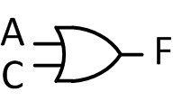
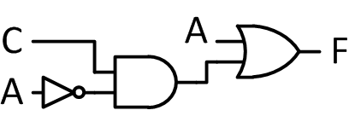
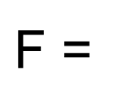

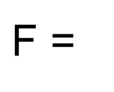

Are Overlapping Groups Bad?
What if we avoid overlap?
BC
A
00
01
11
10
$\text{F}$ =
A
$$\text{+ }\text{C}$$
0
0
1
1
0
1
1
1
1
1
Top circuit is smaller because group is bigger!
BC
A
00
01
11
10
$\text{F}$ =
A
$$\text{+ }\overline{\text{A}}\text{C}$$
0
0
1
1
0
1
1
1
1
1
Notes:
Is it bad to overlap groups? To avoid overlap, we could group the four lower 1s, and then group just the two upper 1s. Notice that the resulting function is more complex, and the resulting circuit is larger.
So the answer is no – overlap is not bad if it lets us make a group larger, which allows us to eliminate more literals from the corresponding term and simplify the hardware.

Slide 14
K-Map Groups
Minimum group size is 1x1 (a single minterm)
Can increase group size by doubling it in a dimension if it still only encompasses 1s*
Each time we double the size of a group, we remove one literal from that group’s product term
Remember: groups can “wrap around” the K-map sides
Groups must be rectangular shapes with each side a power-of-two (1, 2, 4, 8) in length
Bigger groups mean smaller AND gates because it means fewer literals in a product term
Can even eliminate the AND gate if reduced to one literal!
Fewer groups mean fewer AND gates and a smaller OR gate because there are fewer product terms
* Later we’ll see an example of grouping 0s
Notes:
Based on these examples, you’ve probably figured out the strategy for choosing groups in a K-map. First, remember that a group can be as small as 1x1 if contains a 1 not adjacent to any other 1s. Larger groups must always have dimensions that are powers of 2. We need to include all 1s in at least one grouping.
Make each grouping as large as possible to eliminate more literals and make smaller terms and smaller gates. Don’t include any completely redundant groups, though, and use as few groups as possible to make as few gates as possible. The key to using K-maps is to understand the relationship between your groupings in the K-map and the corresponding algebra and the resulting circuit. If you get that down, K-maps should be easy.

Slide 15
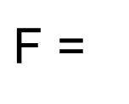



Three-Variable K-Map Examples
BC
A
00
01
11
10
$\text{F}$ =
$$\overline{\text{C}}$$
0
1
0
0
1
This group includes all combinations of A and B for all cases where C is 0
1
1
0
0
1
YZ
X
00
01
11
10
$\text{W}$ =
$$\overline{\text{X}}\text{Z}$$
+ XY
0
0
1
1
0
Don’t need YZ group because we already covered all 1s… Think about difference in the circuit if we include YZ…
1
0
0
1
1
Notes:
We’ll go through a few examples to illustrate key points. In this example, remember that the edges of the K-map wrap around, so we can create one group of 4 instead of two groups of 2.
In the next example, remember that we only need to include each 1 in a single group. If all the 1s are already covered, don’t add more groups!

Slide 16
Extreme Simplification Examples
EF
All K-map squares contain a 1
All in the same group
All variables drop out!
All K-map squares contain a 0
None in any group
All variables drop out!
D
00
01
11
10
0
1
1
1
1
1
1
1
1
1
G(D,E,F) = 1
LM
K
00
01
11
10
0
0
0
0
0
1
0
0
0
0
P(K,L,M) = 0
Notes:
The extreme cases shown here illustrate that a K-map works even if the function is a constant 1 or a constant 0!

Slide 17
Four-Variable K-Maps
A four-variable function has 16 minterms
Organized as a 4x4 array (i.e. two variables per axis)
The numbers on both axis follow a Gray code, not a binary, count
YZ
WX
00
01
11
10
00
m0
m1
m3
m2
01
m4
m5
m7
m6
11
m12
m13
m15
m14
10
m8
m9
m11
m10
Notes:
We can extend the K-map to four variables. Both axes use Gray code, so be careful when filling these in!

Slide 18
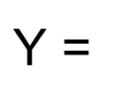



Four-Variable K-Maps Examples
GH
EF
00
01
11
10
00
1
1
0
0
$$\text{+ }\text{EF}$$
$\text{Y}$ =
$$\overline{\text{G}}$$
$$\text{+ }\text{FH}$$
01
1
1
1
0
11
1
1
1
1
10
1
1
0
0
Notes:
In this example, we can cover all 1s in the K-map using three large groupings that represent the optimal two-level implementation. Notice that we couldn’t make these groups any bigger.

Slide 19
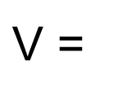


Four-Variable K-Maps Examples
LM
JK
00
01
11
10
00
1
0
0
1
$\text{V}$ =
$$\overline{\text{J}} \text{K} \overline{\text{L}} \text{M}$$
$$\text{+ }\overline{\text{K}} \overline{\text{M}}$$
01
0
1
0
0
The four corners grouping is commonly overlooked…
The K-Map wraps around at all edges due to Gray code!
11
0
0
0
0
10
1
0
0
1
Notes:
All of the 1s in the K-map, even those with no other adjacent 1s, must be accounted for.
Also, remember that the edges of a K-map wrap around, so the four corners of the K-map can be grouped! If you’re not sure why that works, do the algebra to simplify those four minterms, and see that you get the same result.

Slide 20
Why Not More Than Four Variables?
Too hard to visualize in 3 or more dimensions
Systematic approach: “Tabular Methods”
Used in computer programs
Why K-Maps at all?
Faster for quick optimizations
Understand Boolean logic and HW design
Design with simplification in mind
Six-Variable K-Map:
Notes:
For 5 or 6 variables, we need to expand the K-map to three dimensions. To go beyond 6 variables, we would need four dimensions. Anyone want to work with a hypercube K-map…?
Even a three-dimensional map is tough to use, so we would optimize this function using a computer program based on tabular methods or other algorithms. In this class, we’ll only use K-maps with at most four variables.

Slide 21
ECE 352 Digital System Fundamentals
Introduction to K-Maps
Notes:
This concludes our introduction to K-maps.

